Slide 1
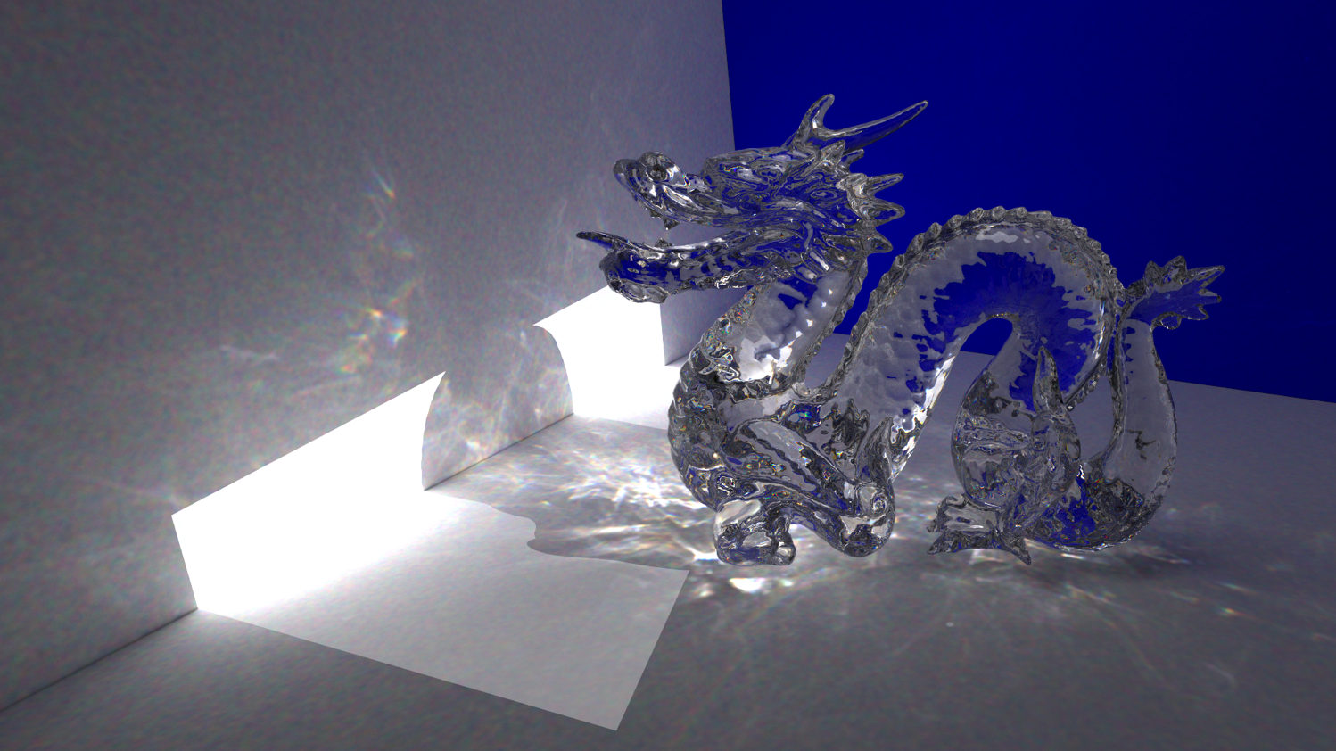
Path Tracing Review
Morgan McGuire
CS888 Fall ‘19
University of Waterloo

Slide 2
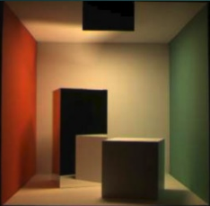
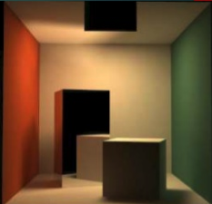
Which is Real?
Notes:
Left image is a photograph, right image is rendered by path tracing. This famous ground-truth test of a renderer is the origin of the “cornell box” 3D models—there’s a real box at Cornell.
Of course, modern renderers with good input can simulate non-realistic scenes:

Slide 3
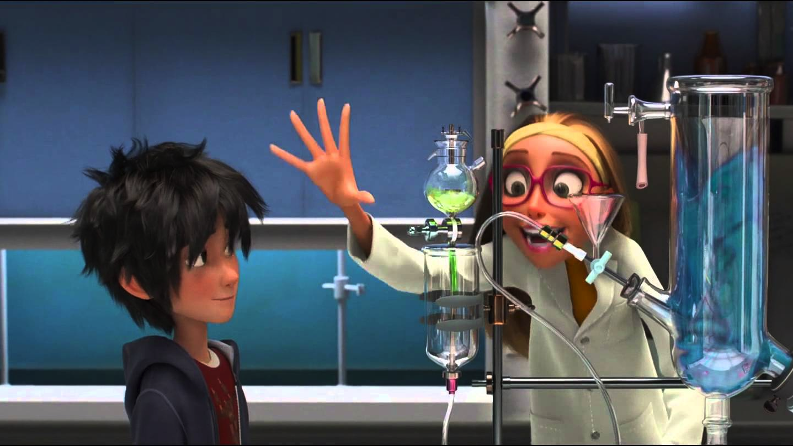
Big Hero 6
Notes:
In a way that still has realistic lighting, or fantastical geometry as if it was real…

Slide 4
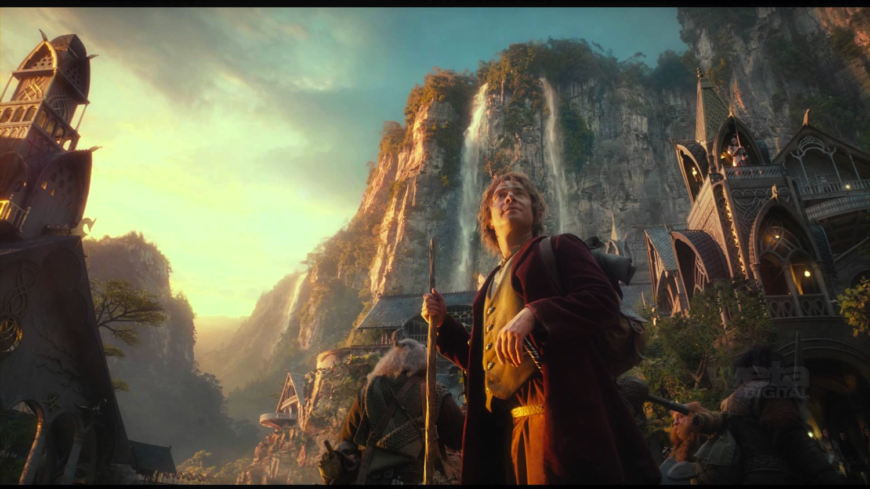
The Lord of the Rings
Notes:
I can’t tell what is captured by a camera and what is rendered anymore in movies…

Slide 5
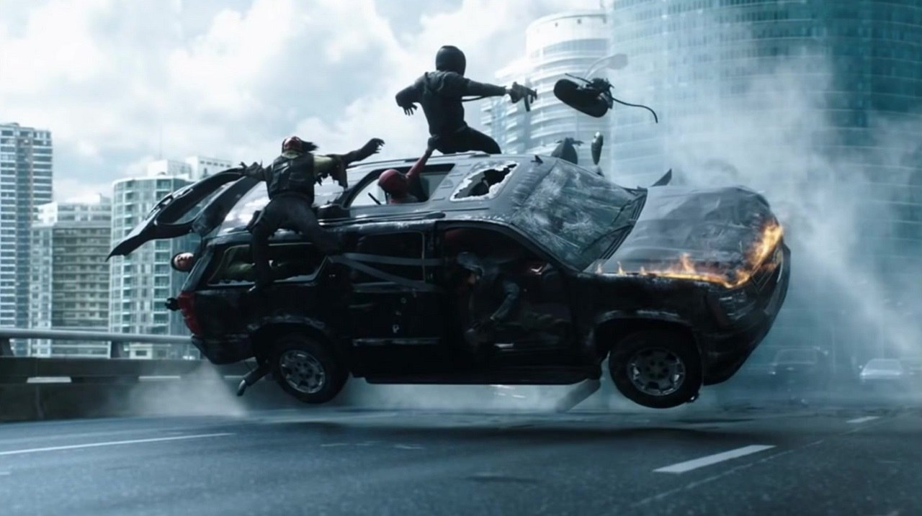
Deadpool
Deadpool
Notes:
In this scene from Deadpool, you probably expect there to be some computer graphics…

Slide 6
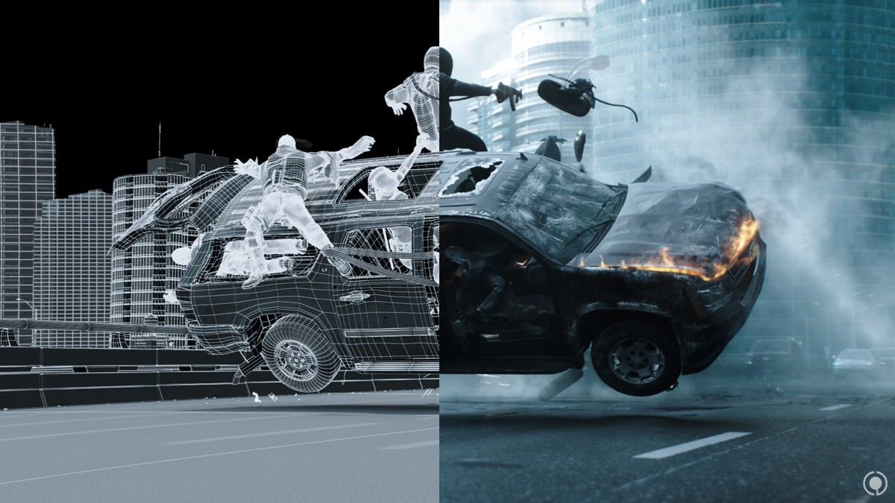
Deadpool
Notes:
But did you expect the entire scene to be CGI?
Action movies are increasingly like this…

Slide 7
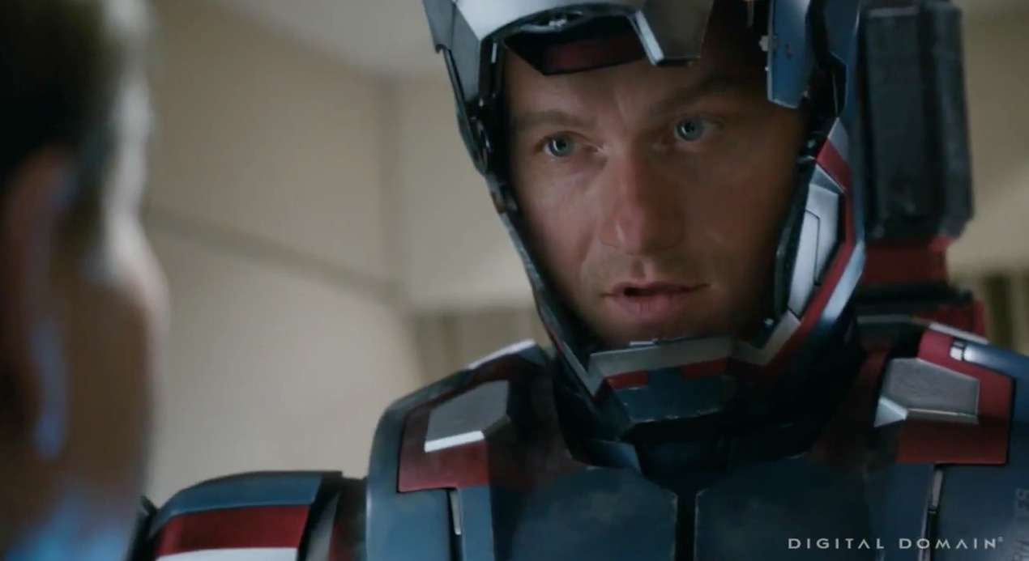

Slide 8
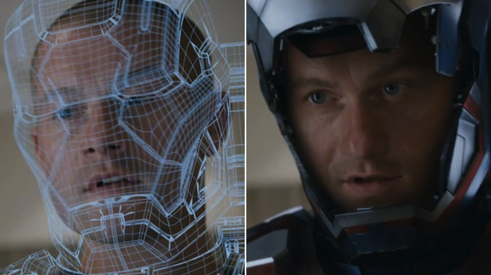
Iron Man 3

Slide 9
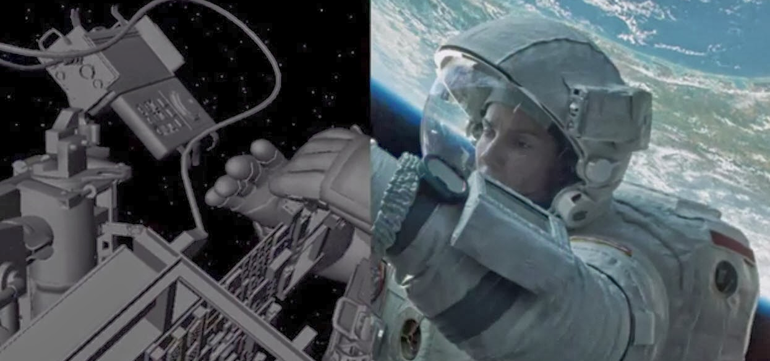

Slide 10
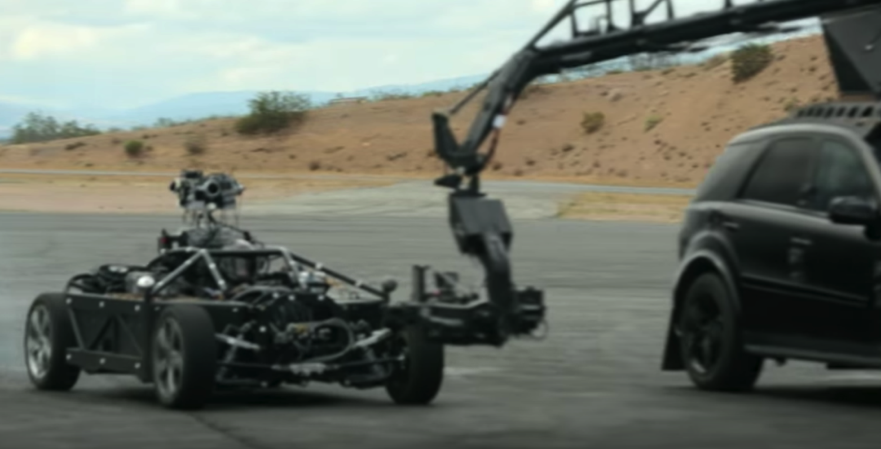
https://www.youtube.com/watch?v=OnBC5bwV5y0
Notes:
And pretty much every car commercial and car scene in a film is now virtual, thanks to The Mill, one of my favorite VFX studies.
This is terrific stuff. Let’s review the math that you studied previously in other graphics courses that lets us create algorithms for rendering images like these.

Slide 11
Measurements
Quantity | Symb. | SI Unit | 1 ≈
Distance | x | meters (m) | Counter height
Area | A | Square meters (m²) | Desk top
Angle | θ | radians (rad) | 57 degrees Northermost latitude in ON
Solid Angle | Γ | steradians (sr) | Dodecahedron face The Americas
Power (energy/time) | Φ | Watts (W) | Cell phone flashlight
Radiance | L | W/(m² sr) | A bright indoor ray
“Biradiance” | β | W/m² | Cell flashlight at arm’s length
Notes:
A tall person has a height of 2m and surface area of 2m^2.

Slide 12
Data Structures
class Vector3 {
public: float x, y, z;
};
typedef Vector3 Point3;
class Ray {
public:
Point3 origin;
Vector3 direction;
};
class Color3 {
public: float r, g, b;
};
typedef Color3 Radiance3;
typedef Color3 Power3;
class Light {
public:
Power3 power;
Point3 position;
};
class Image {
public:
Array<Color3> pixel;
int width, height;
};
class Surface {
public:
Array<Point3> position;
Array<int> index;
};
Notes:
Stop for questions on what we covered last time.

Slide 13
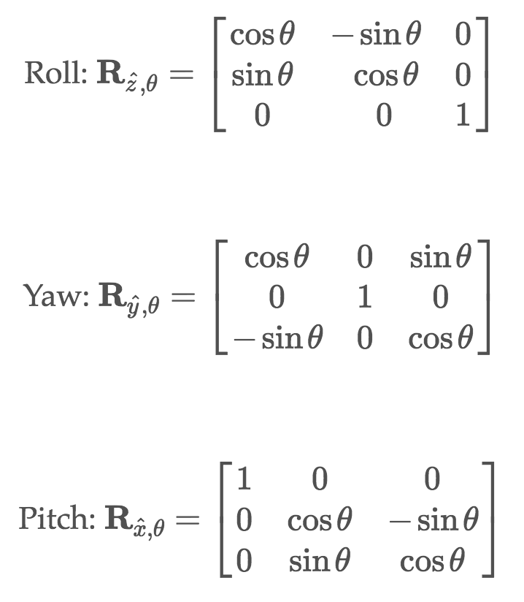
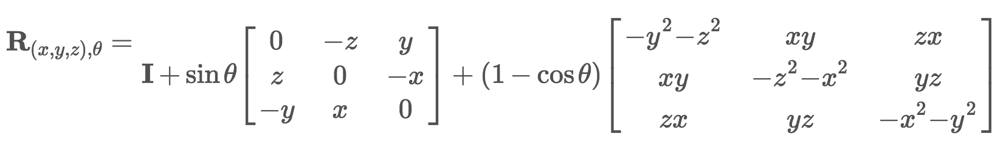
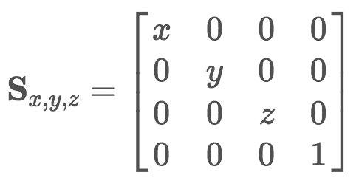
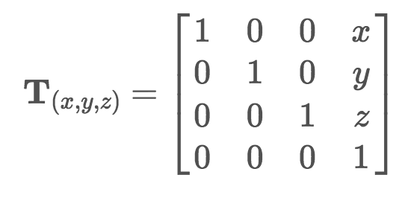
Transformations

Slide 14
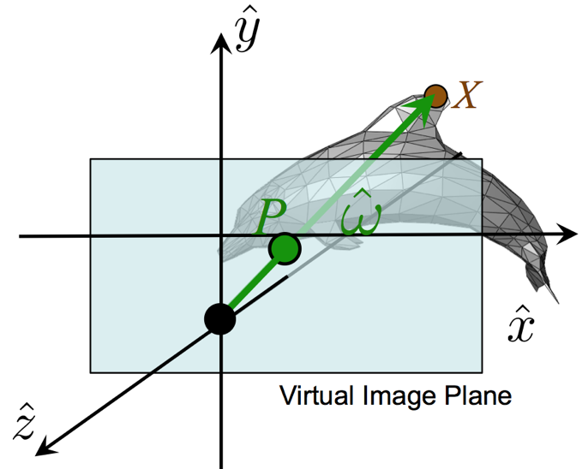
Primary Rays
Screen space:
x, y, w, h
World space:
z_{P} = –1
H = –2 tan(θ_{y} / 2) z_{P}
W = H * w / h
y_{P} = – (y / h – ½) * H
x_{P} = (x / w – ½) * W
w
h
Notes:
(You don’t have to do this in this week’s project)

Slide 15
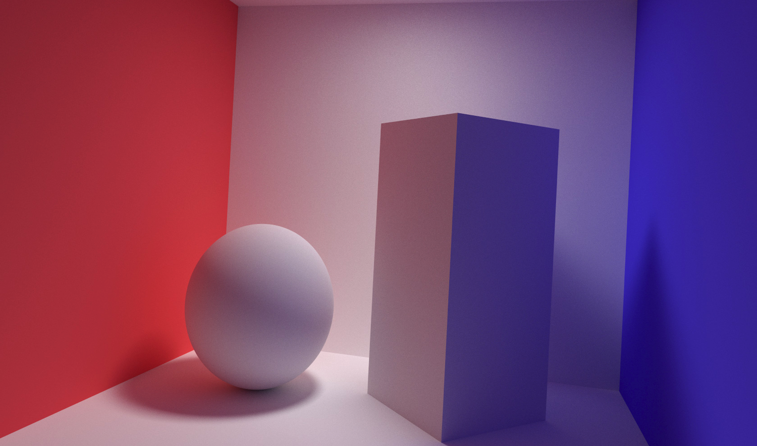
Phenomena

Slide 16
“Soft Shadows”
“Color Bleeding”
“Diffuse Interreflection”

Slide 17
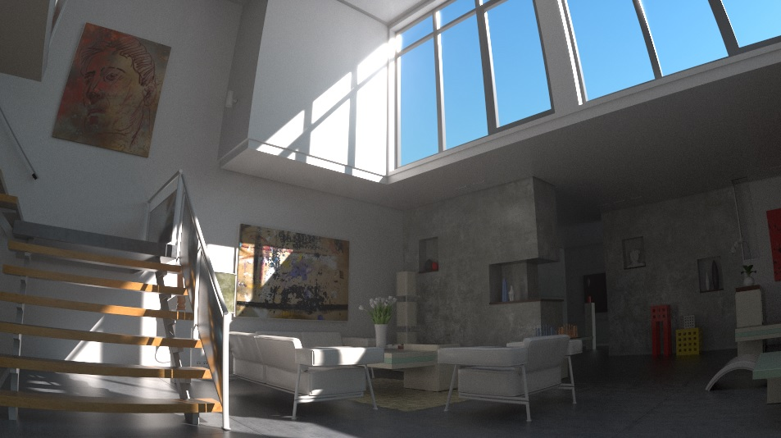
“Indirect Lighting”

Slide 18
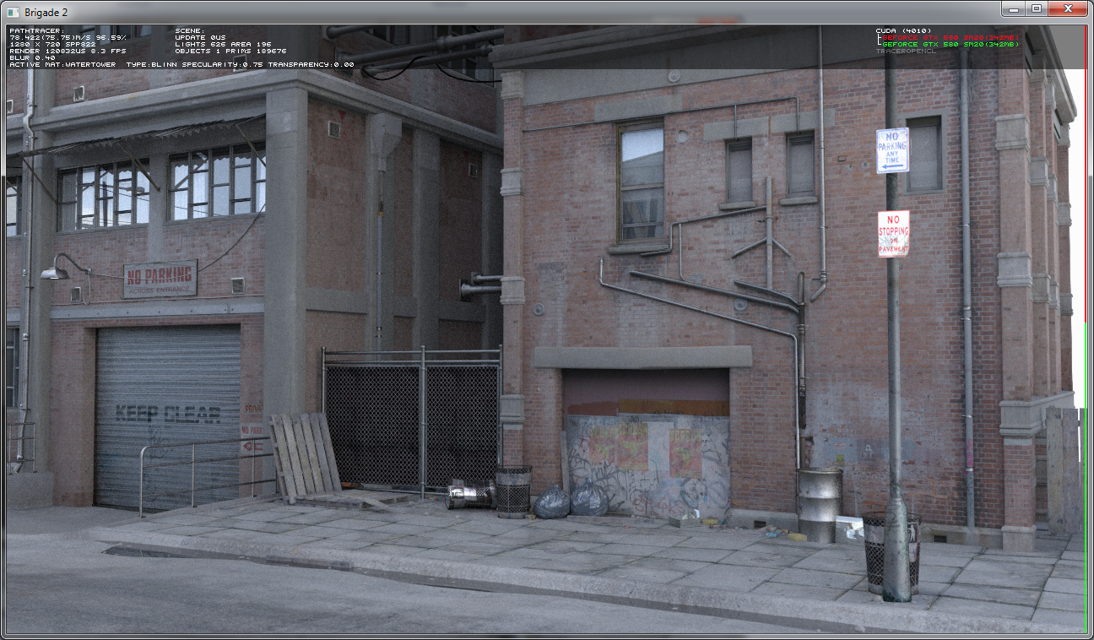
“Ambient Occlusion”

Slide 19
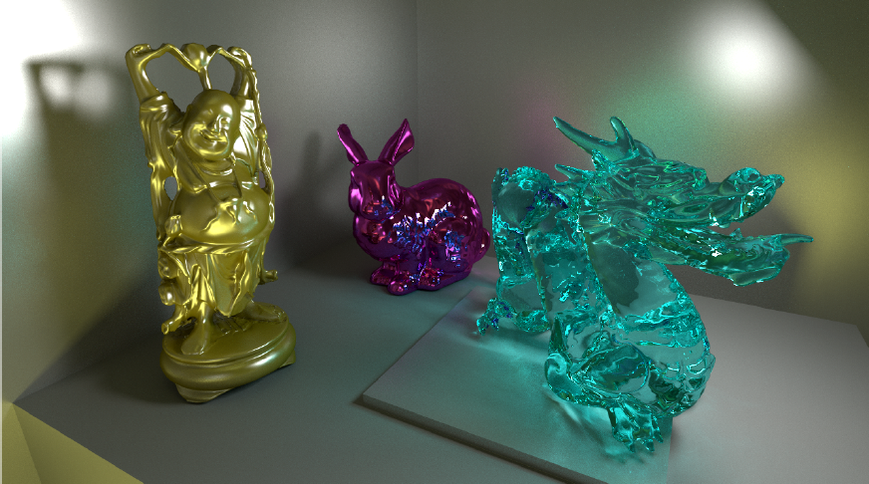
“Transmission”
“Glossy Reflection”

Slide 20
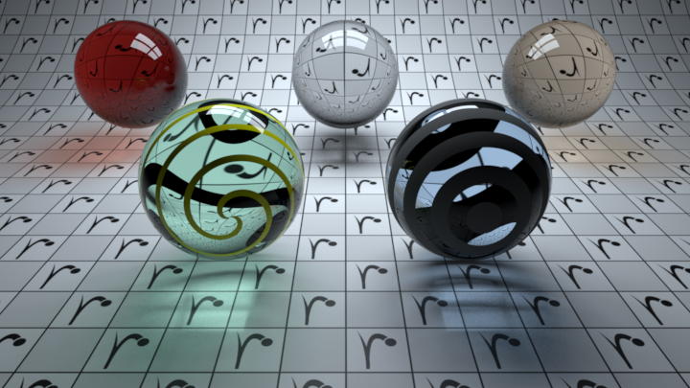
“Caustics”
Notes:
Here’s the caustics that were one of Kajiya’s motivations for creating path tracing. They really help with the appearance of translucent materials and some curvy reflective ones.
Ironically, real caustics are often suppressed in film production because it is confusing when there’s a bright spot somewhere in a scene, like the reflection on the ceiling off someone’s watch face. They get painted out of the final frame or the director moves lights and roughens surfaces to hide them. So maybe we shouldn’t spend so much time in research trying to make algorithms to generate them. The most visually important case of caustics is probably in the ocean, and that is often faked in games and film using projective textures, which are easier to art direct than real emergent caustics.

Slide 21
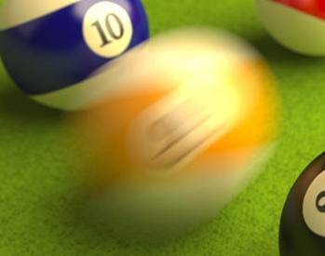

Motion Blur
Defocus Blur (“Depth of Field”)
Notes:
There are good algorithms, including Cook et al. 84 for generating motion blur and depth of field phenomena via ray tracing. However, making the ray-triangle intersection efficient for motion blur in particular is tricky—time is the one parameter that affects the intersection instead of the ray generation or shading, and it breaks Kajiya’s original steady-state assumption in the rendering equation (notice that he had no “time” parameter). Note that even APIs offer limited support—there’s no “time” parameter for the DirectX or Vulkan GPU ray tracing APIs, and the assumption is that you’ll approximate these effects by post-processing the frame with a blur filter.

Slide 22
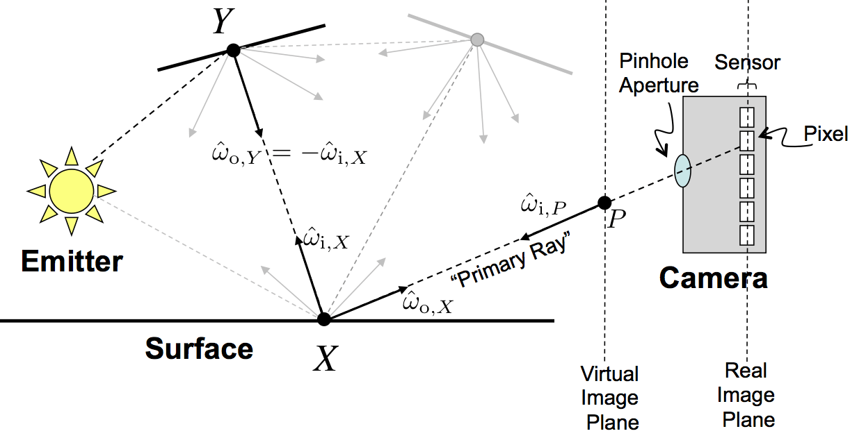
The Rendering Equation

Slide 23
The Rendering Equation
Outgoing direction
Incoming direction
A point in the scene
All incoming directions
(a sphere)
Notes:
L_\mathrm{o}(X, \hat{\omega}_\mathrm{o}) = L_\mathrm{e}(X, \hat{\omega}_\mathrm{o}) + \int_{\mathbf{S}^2} L_\mathrm{i}(X,\hat{\omega}_\mathrm{i})~f_X(\hat{\omega}_\mathrm{i}, \hat{\omega}_\mathrm{o})~|\hat{\omega}_\mathrm{i} \cdot \hat{n}|~d\hat{\omega}_\mathrm{i}

Slide 24
The Rendering Equation
Outgoing light
Emitted light
Incoming light
Material
Notes:
L_\mathrm{o}(X, \hat{\omega}_\mathrm{o}) = L_\mathrm{e}(X, \hat{\omega}_\mathrm{o}) + \int_{\mathbf{S}^2} L_\mathrm{i}(X,\hat{\omega}_\mathrm{i})~f_X(\hat{\omega}_\mathrm{i}, \hat{\omega}_\mathrm{o})~|\hat{\omega}_\mathrm{i} \cdot \hat{n}|~d\hat{\omega}_\mathrm{i}

Slide 25
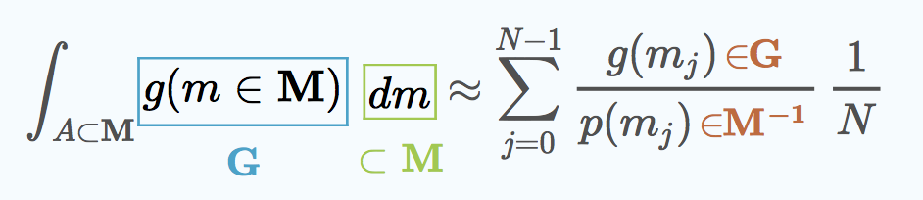
Monte Carlo Integration
Integrand
Number of samples
The integral we’re estimating
Probability density function for choosing m
Notes:
Note that the units check out…the left side has units from [G] * [M], and the right is [G] / [M]^-1
p() is a continuous probability DENSITY function. It has to be non-negative everywhere and integrate to 1 over M. It can have individual values of any magnitude, though, including infinity, as long as that is for a very small portion of the domain.

Slide 26
Monte Carlo Integration
Notes:
\int_A g(m) ~ dm\approx \sum_{j=0}^{N-1}\frac{g(m_j)}{p(m_j)}\frac{1}{N}

Slide 27
Limiting Case
Let N = 1
Notes:
\int_{\mathbf{S}^2} L_\mathrm{i}(X,\hat{\omega}_\mathrm{i})~f_X(\hat{\omega}_\mathrm{i}, \hat{\omega}_\mathrm{o})~|\hat{\omega}_\mathrm{i} \cdot \hat{n}|~d\hat{\omega}_\mathrm{i}
The simplest version of the integrator takes a single sample and uses that as the value, weighting it by 1/p
Let’s take this simple case and subsititute the rendering equation’s integral into it…

Slide 28
Pure Path Tracing
Let
Notes:
\int_{\mathbf{S}^2} L_\mathrm{i}(X,\hat{\omega}_\mathrm{i})~f_X(\hat{\omega}_\mathrm{i}, \hat{\omega}_\mathrm{o})~|\hat{\omega}_\mathrm{i} \cdot \hat{n}|~d\hat{\omega}_\mathrm{i}
L_\mathrm{i}(X,\hat{\omega}_\mathrm{i})~f_X(\hat{\omega}_\mathrm{i}, \hat{\omega}_\mathrm{o})~|\hat{\omega}_\mathrm{i} \cdot \hat{n}| ~ 4\pi~\mathrm{sr}
L_\mathrm{i}(X,\hat{\omega}_\mathrm{i})=L_\mathrm{o}(Y,-\hat{\omega}_\mathrm{i})
L_\mathrm{o}(X,\hat{\omega}_\mathrm{i})=L_\mathrm{e}(X,\hat{\omega}_\mathrm{i})+\int_{\mathbf{S}^2}\!\!\!\!\cdots d\hat{\omega}_\mathrm{i}
Let the pdf be uniform on the sphere. How do I choose an incoming vector uniformly at random on the sphere? Easy: choose a uniform point in the [-1, 1]^3 cube. Throw it away if it is outside of the sphere and try again.
Points in the unit radius ball map equally to the sphere, so if you just normalize the resulting point, it will be a uniformly distributed vector
The whole thing now boils down into this simple expression, which is just the integrand applied to a random direction times 4 pi

Slide 29
Pure Path Tracing
Notes:
Let’s put it all together for a complete solution
\int_{\mathbf{S}^2} L_\mathrm{i}(X,\hat{\omega}_\mathrm{i})~f_X(\hat{\omega}_\mathrm{i}, \hat{\omega}_\mathrm{o})~|\hat{\omega}_\mathrm{i} \cdot \hat{n}|~d\hat{\omega}_\mathrm{i}
\approx\frac{L_\mathrm{i}(X,\hat{\omega}_\mathrm{i})~f_X(\hat{\omega}_\mathrm{i}, \hat{\omega}_\mathrm{o})~|\hat{\omega}_\mathrm{i} \cdot \hat{n}| ~ 4\pi~\mathrm{sr}
L_\mathrm{i}(X,\hat{\omega}_\mathrm{i})=L_\mathrm{o}(Y,-\hat{\omega}_\mathrm{i})
L_\mathrm{o}(X,\hat{\omega}_\mathrm{i})=L_\mathrm{e}(X,\hat{\omega}_\mathrm{i})+\int_{\mathbf{S}^2}\!\!\!\!\cdots d\hat{\omega}_\mathrm{i}
Let the pdf be uniform on the sphere. How do I choose an incoming vector uniformly at random on the sphere? Easy: choose a uniform point in the [-1, 1]^3 cube. Throw it away if it is outside of the sphere and try again.
Points in the unit radius ball map equally to the sphere, so if you just normalize the resulting point, it will be a uniformly distributed vector
And you just run a SECOND Monte Carlo integration by running this at each pixel many times and averaging the results.
That’s it. No shadow rays, no direct illumination, no biradiance.

Slide 30
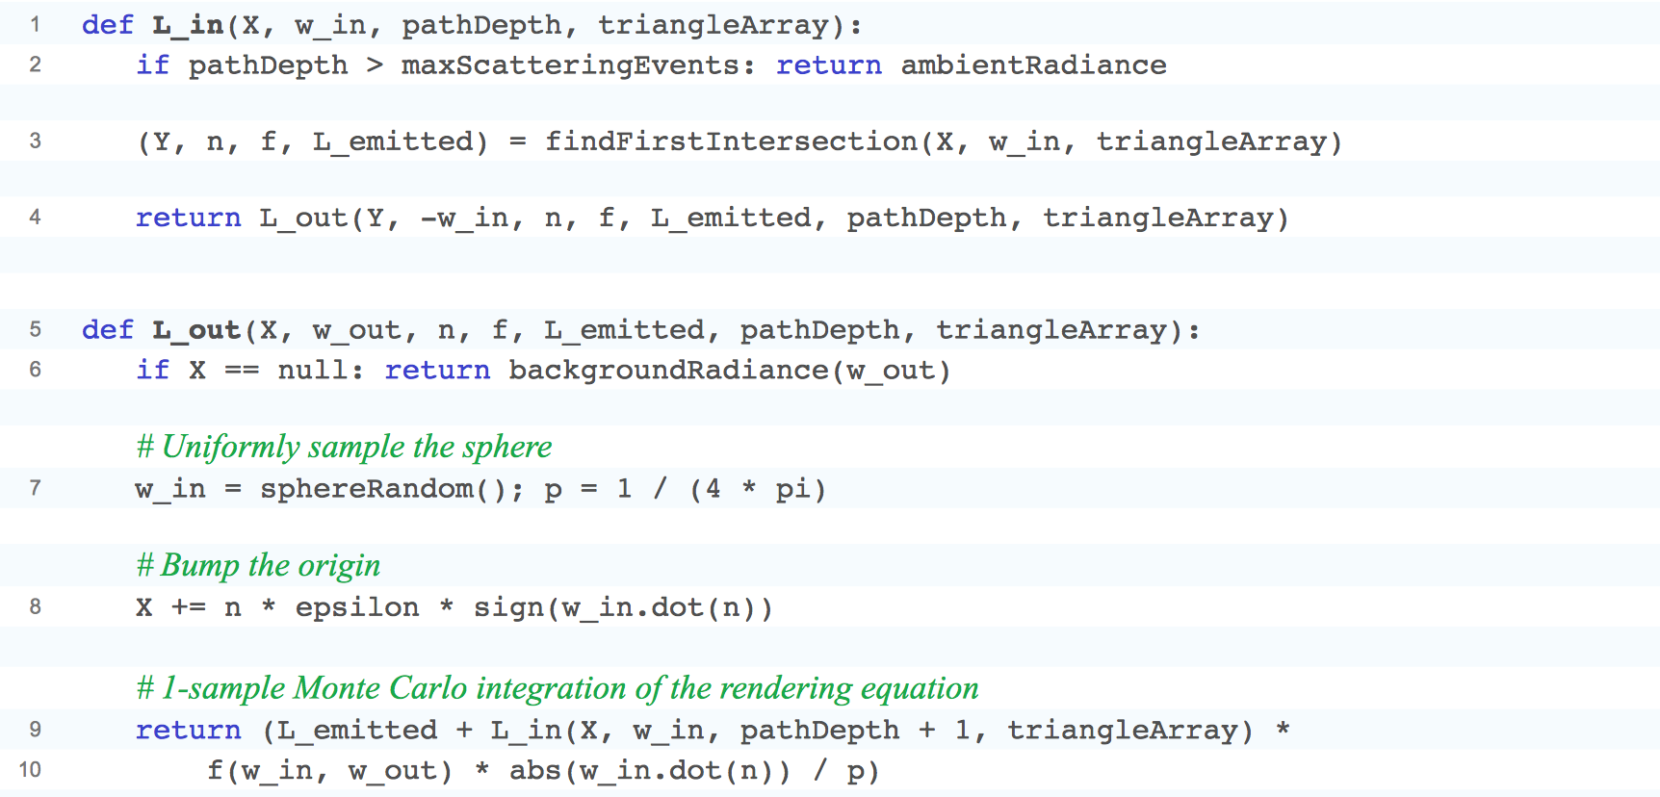
Core Implementation
Notes:
This is really the only light transport code that you need to turn any mesh with non-impulse materials…

Slide 31
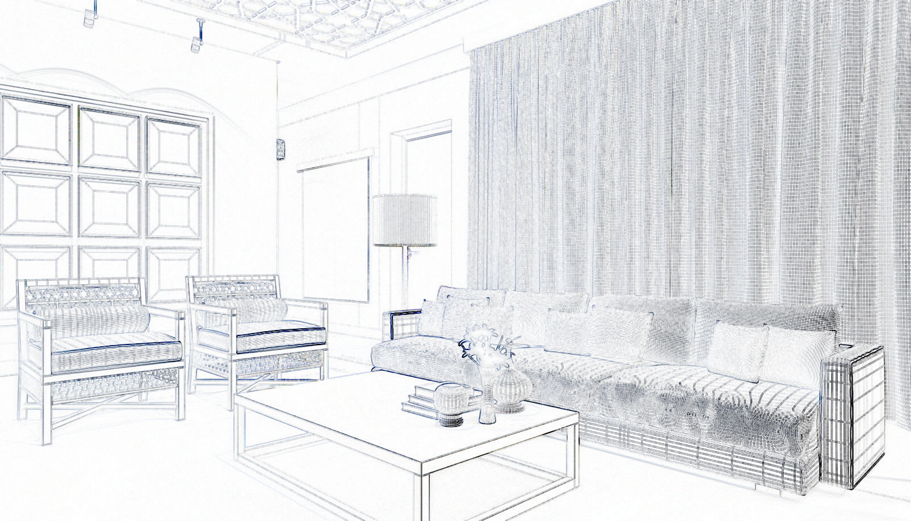
Notes:
Like this, into this…

Slide 32

Notes:
And to kick it off, you just need a main loop that iterates over pixels…

Slide 33
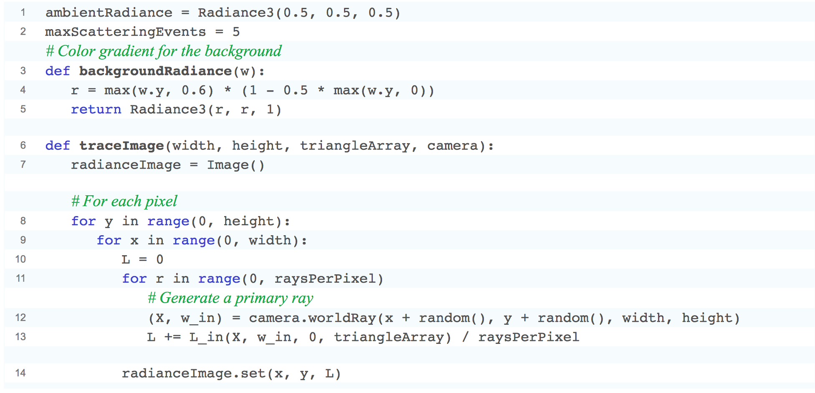
Pixel Integrator
Notes:
Note that this casts multiple rays at each pixel and averages their results. That’s a Monte Carlo Integrator applied to the pixel values instead of the rendering equation.
There are only two problems with this elegant solution:

Slide 34
Remaining Problems
Increase convergence rate
Handle impulses in L_{i} and f_{X}
Notes:
It converges really slowly. You’d need millions of rays per pixel to get glossy surfaces to look good
It can’t handle impulses in L_in (Point lights!) or in f (mirrors and refraction!)
We can fix both with an algorithmic optimization called importance sampling…

Slide 35
Importance sampling

Slide 36
Choose
O(N) evaluations of g and p
Small g(m) values are inefficient: integral value per compute time is small
Ideal: choose p(m) = g(m) / c
Notes:
“

Slide 37
Sampling Scattering
How do we choose p proportional to the integrand we don’t yet know?
”BSDF importance sampling” assumes L_{i} is constant and chooses
Notes:
Monte Carlo integration tells us that it would be optimal to make the denominator probability density function p() proportional to the integrand in the numerator. But the whole point was that we don’t yet know the value of the numerator. What do we do?
One solution is that assume that light comes into this point X equally from all directions (it doesn’t matter for correctness if this assumption is wrong, and it is often pretty reasonable). In that case, the hard value to compute: the incoming light, goes away and we are just sampling from a probability distribution that is proportional to the cosine-weighted material.

Slide 38
Sampling Scattering
𝜔_{i}, weight = scatter(X, n, 𝜔_{o})
Where:
weight =
Notes:
This also solves the problem of impulses (infinite values with zero range) in f() [and less importantly, in L]. We just build a function…or more likely, call into a library routine…that gives us the ratio of f*cos / p() after sampling (called a weight), where it will handle the infinities and make them “cancel” by taking a limit as the value approaches the impulse.
This also solves the problem of how we can choose a single ray when we have different values of f for difference frequencies (colors) of light: the weight is spectral, and varies depending on the ratio of f(lambda) to the monochrome p(w).
We’ll later see strategies for reducing the assumption that the light is uniform during scattering importance sample, including multiple importance sampling and neural importance sampling. This is an active area of research with many recent results.

Slide 39
Direct Illumination
Monte Carlo integration of direct illumination
Compute biradiance β_{j} for a set of patches on lights
(assume no shadows)
Choose light patch j with probability p = β_{j} / Σβ_{k}
Only cast a shadow ray to patch j
Compute direct illumination as
Tip: implement direct illumination from all lights at first with a loop. This is an optimization.
Notes:
Pure” path tracing doesn’t work for point lights. There’s zero probability that a ray hits a point light, and if it did, the radiance would be infinite. So, we have to put direct illumination, shadow rays, and biradiance back in to make point lights (vs. area lights) work. Sorry. We only use path tracing for indirect light. BUT: The direct illumimation code is a lot faster than hoping a random ray will hit the light source.
This is straight up importance sampling, except that we don’t know the cumulative distribution function for the lights…so we estimate that stochastically as well.
This is called importance resampling and was introduced to graphics by Talbot et al. 2005 https://dl.acm.org/citation.cfm?id=2383674, but the core idea is from stats and goes back to Rubin 1987.

Slide 40
Three Separate Monte Carlo Integrators in Basic Path Tracing
Pixel Area:
large N
p = uniform on square
Direct Illumination:
N = 1
p = relative biradiance
Indirect Illumination:
N = 1
p

Slide 41
Summary
The Rendering Equation describes steady-state recursive light flow
Monte Carlo integration: add random samples weighted by the probability of choosing them
Pure path tracing is amazingly simple: MC integrate the Rendering Equation
Importance sampling makes path tracing more efficient and elegantly handles impulses [e.g., perfect mirrors]
For full details, see the Graphics Codex 2.17 chapters on Materials, Numerical Calculus, and Path Tracing

